Slide 1

Improve customer experience of THE LELAND HOME
Shengjie xia, Ziyue Wang, Nick Chen,
Shuanghanyue Li, Lin Li, Zhendong Yin

Slide 2
BACKGROUND
OVERVIEW
Long history: founded in1879
Target group: serve seniors(older than 62)
Home like service
Daily assistance
CHALLENGE
Confusion: inadequate information
Covid-19
Lack of Feedback
Not suitable for elderly communication and guidance
Customer experience improvement

Slide 3
RESEARCH
SERVICE
Website information
Features and Amenities
Service process & category
PROBLEMS
Confusing website drives customer away
Inadequate information

Slide 4
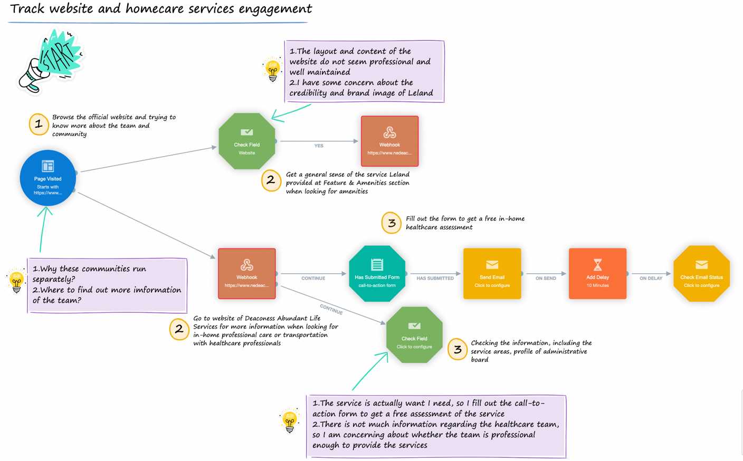

Slide 5
SOLUTION
Customer Journey Mapping
Guide the entire process
Customer sentiment analysis
Detect the pain point of the customer searching experience
Voice service
Help the elderly who have difficulty reading the content
Different language choices
Provide translation tool
Search Engine optimization & content Strategy
Develop blog and post events and activity regarding the daily life of older
Maintain and add additional information regarding the services and the profile of the professional team on the website
Matches the content with search engine keywords

Slide 6
CONCLUSION
Attracting and simpler pages
More details on the website
Presence of Customer Feedback
More age-friendly audio Tours
Counseling professionals

Slide 7

THANKS

